Slide 1


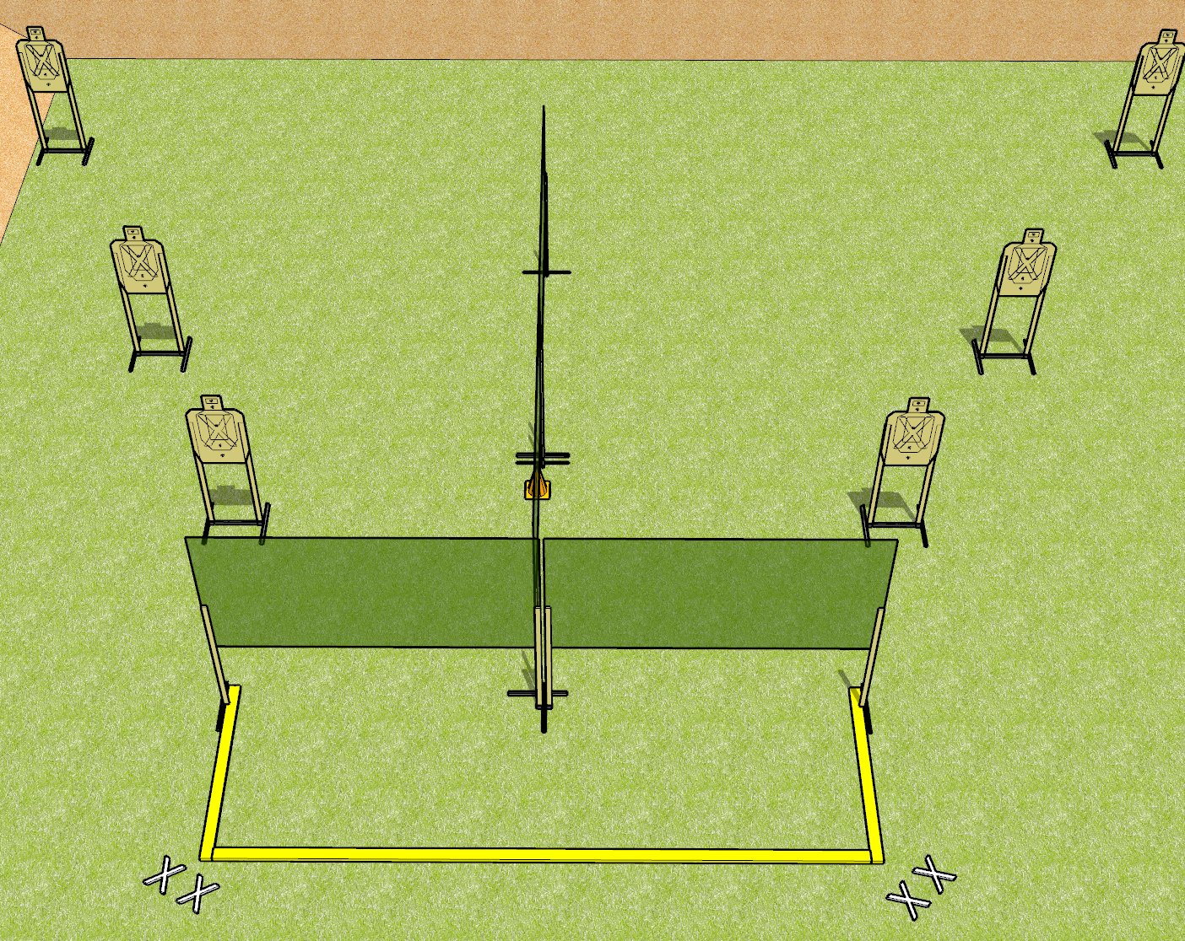
 | Dothan Gun Club – USPSA Match I Have Standards Course Designer : Drew Coleman
START POSITION : String 1: standing on either set of X’s, hands relaxed at sides. String 2: standing on opposite set of X’s, hands relaxed at sides.
GUN READY CONDITION : Pistol loaded and holstered. PCC shouldered, safety on, pointed at orange cone. |  | SCORING: Virginia Count, 24 rounds TARGETS: 6 paper, 0 Steel SCORED HITS: Best 4 on paper, steel until down START-STOP: Audible, last shot RULES: Failure to perform a mandatory reload will be a procedural per shot fired. Failure to fire last 6 rounds strong/weak hand only will be a procedural per shot fired.
STAGE PROCEDURE: String 1: engage each target with 2 rounds each, perform a mandatory reload then engage each target with 2 rounds. The last 6 shots fired must be strong hand only. String 2: engage each target with 2 rounds each, perform a mandatory reload, then engage each target with 2 rounds. The last 6 shots fired must be weak hand only

